Slide 1
INDUSTRIAL INTERNSHIP
NAME: HUNAID SAIFEE SIAMWALA
CLASS: 8CE-1
ROLE: PYTHON FULL STACK DEVELOPER

Slide 2

COMPANY : QSpiders – A Unit of Test Yantra Software Solutions India Pvt. Ltd.

Slide 3

COMPANY PROFILE
QSpiders is a Unit of Test Yantra Software Solutions India Pvt Ltd
QSpiders is the world’s ace software training organization with an aim to bridge the gap between the demands of the industry

Slide 4
COMPANY DETAILS
Address: No. 5th & 6th Floor, Peninsula Plaza Between Stadium Circle & Swastik Cross Road, Chimanlal Girdharlal Rd, Ahmedabad, Gujarat
E-mail ID: enquiry@qspiders.com
Website: www.qspiders.com

Slide 5
MENTOR DETAILS
Name: Shivu D Shetty
Designation: Branch Head
E-mail: shivu.d@qspiders.in

Slide 6
H-SHOP : AN E-COMMERCE WEBSITE USING DJANGO
This project is a comprehensive e-commerce website developed using Django, a high-level Python Web framework. The website is designed to provide a user-friendly experience for online shopping and includes a variety of modules to ensure smooth operation and secure transactions.

Slide 7
AIM AND OBJECTIVE OF THE PROJECT
The primary aim of this project is to design and implement a fully functional e-commerce website using Django, a powerful Python web framework. The website aims to provide a seamless and secure online shopping experience for users.
The objectives of the project include:
User-Friendly Interface: To develop an easy-to-navigate and user-friendly interface that allows users to browse products, add them to the cart, and make purchases with ease.
Secure Authentication: To implement secure user registration and login modules that protect user data and prevent unauthorized access.
Efficient Order Management: To create an efficient order management system that tracks user orders, confirms successful transactions, and provides order details.
Email Notifications: To set up automated email notifications for various events such as registration, order confirmation, and password reset.
Detailed Product Information: To provide detailed information about each product, helping users make informed purchasing decisions.
User Profile Management: To allow users to manage their profiles, including personal information, order history, and shipping details.
Secure Payment Gateway: To integrate Razorpay for secure online transactions, ensuring user’s financial data is protected.
Effective Shipping Management: To manage the delivery process effectively, including features like tracking delivery and updating shipping addresses.

Slide 8
MOTIVATION
The motivation for developing this e-commerce website using Django stems from the increasing reliance on online shopping platforms in today’s digital age. With the advent of the internet, the way people shop has drastically changed. E-commerce has become a crucial part of our daily lives, offering convenience, variety, and easy access to products from around the world.
The project was driven by the desire to understand and implement the functionalities of an e-commerce platform, which is a complex system involving various aspects such as user interface design, database management, secure authentication, payment gateway integration, and efficient order processing.
Furthermore, the choice of Django as the development framework was motivated by its robustness and versatility.
Lastly, the project was also motivated by the educational value it provides. Building an e-commerce website from scratch is a great way to learn and apply various aspects of web development, including front-end and back-end programming, database management, user authentication, and more. It offers a practical, hands-on approach to learning that can complement theoretical knowledge.
In conclusion, the motivation for this project lies in the intersection of technological advancement, educational enrichment, and the growing significance of e-commerce in the global economy.

Slide 9

TECHNOLOGY LEARNED
Language : Web Technology
A robust understanding of Web Technologies, such as HTML, CSS, and JavaScript, is crucial for front-end development.
During my internship, I refined my abilities in these fundamental web technologies. I developed proficiency in crafting semantic HTML markup, applying styles to web pages using CSS, and introducing interactive features with JavaScript.

Slide 10
TECHNOLOGY LEARNED
Language : SQL
The Structured Query Language, or SQL, is a potent and standardized programming language that is employed for the administration and alteration of relational databases. In relation to my internship, gaining proficiency in SQL is vital as it constitutes the foundation for database interactions in numerous web applications.

Slide 11
TECHNOLOGY LEARNED
Language : Python
Python is a high-level, general-purpose programming language known for its simplicity and readability. It has a vast ecosystem of libraries and frameworks that make it suitable for various applications, including data analysis and visualization. Some key features of Python for data analysis are:
Libraries
Easy-to-learn syntax
Active community support

Slide 12
TECHNOLOGY LEARNED
Language : Django
Django is a Python-based web framework known for its “Don’t Repeat Yourself” principle, promoting rapid development and clean design. It offers a built-in admin interface, an Object-Relational Mapping (ORM) for database interactions, middleware classes for session management and authentication, and a template engine for building dynamic web pages. Django’s URL routing system allows for efficient URL design, decoupling URLs from Python code. Its robustness and versatility make it an excellent choice for complex applications like e-commerce websites.

Slide 13
SOFTWARE AND HARDWARE REQUIREMENTS
Operating System: Windows, MacOS
Languages: JavaScript, HTML, CSS, Python, Bootstrap
Framework: Django
Database: SQLite (included with Django by default)
Internet Browser: Microsoft Edge, Google Chrome, or any other
Code Editor: Visual Studio Code, or any other

Slide 14
SYSTEM ANALYSIS
The system analysis of this e-commerce website project involves understanding and documenting the functional and non-functional requirements of the system. The functional requirements include modules like product addition, user authentication, cart management, email notifications, order processing, and secure payment gateway integration. The non-functional requirements involve aspects like system performance, security, and user experience. The system is designed to be user-friendly, secure, and efficient, providing a seamless online shopping experience. The choice of Django as the development framework ensures robustness and scalability, catering to potential growth in user traffic and product catalog size.

Slide 15
SYSTEM DESIGN
The system design of this e-commerce website involves a well-structured architecture, ensuring efficient data flow and functionality. The website is divided into modules like product addition, user authentication, cart management, email notifications, order processing, and secure payment gateway integration. Each module has been designed to perform specific tasks, ensuring separation of concerns. Django’s Model-View-Controller (MVC) architecture is leveraged for this purpose. The database design ensures efficient storage and retrieval of product and user data. The user interface is designed to be intuitive and user-friendly, enhancing the overall user experience. The system design also prioritizes security, especially in user authentication and payment processing.

Slide 16
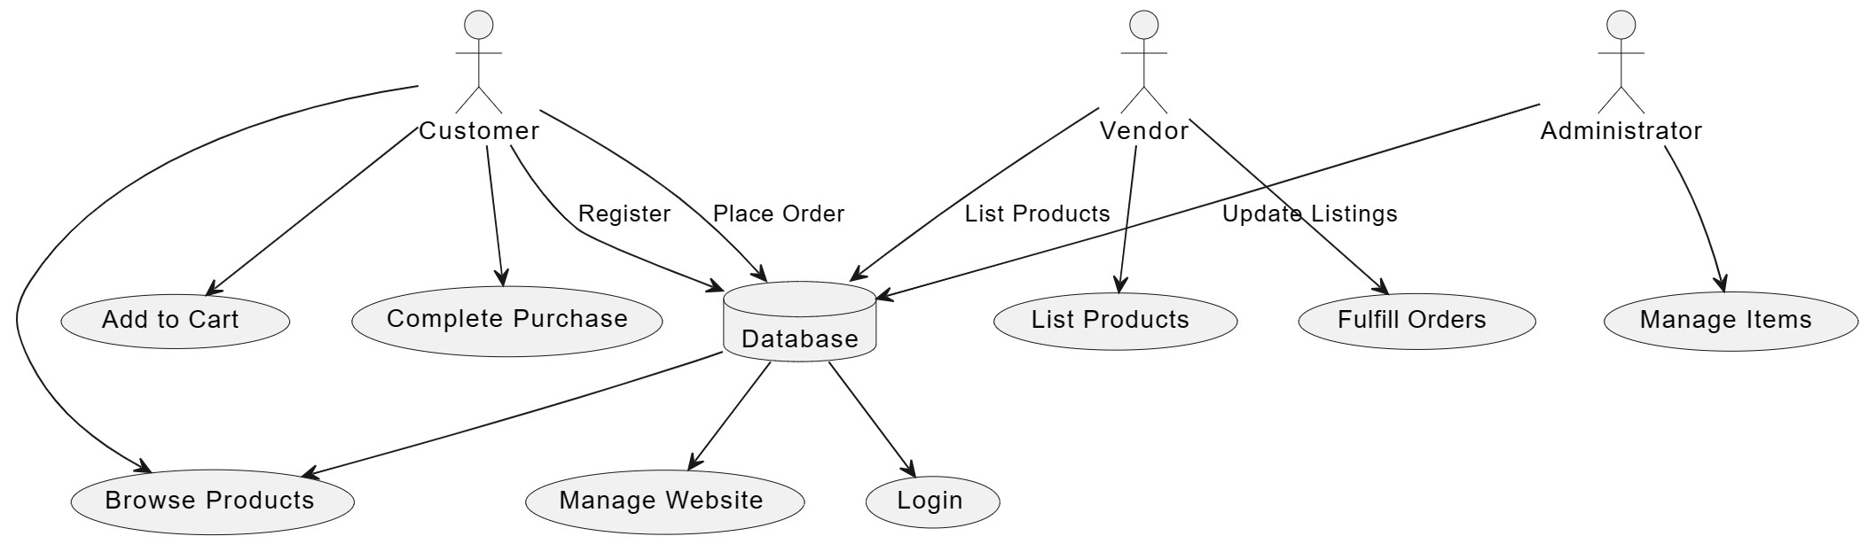
SYSTEM FLOW – DATA FLOW DIAGRAM

Slide 17
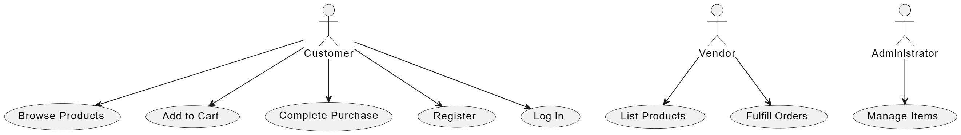
SYSTEM FLOW – USER CASE DIAGRAM

Slide 18
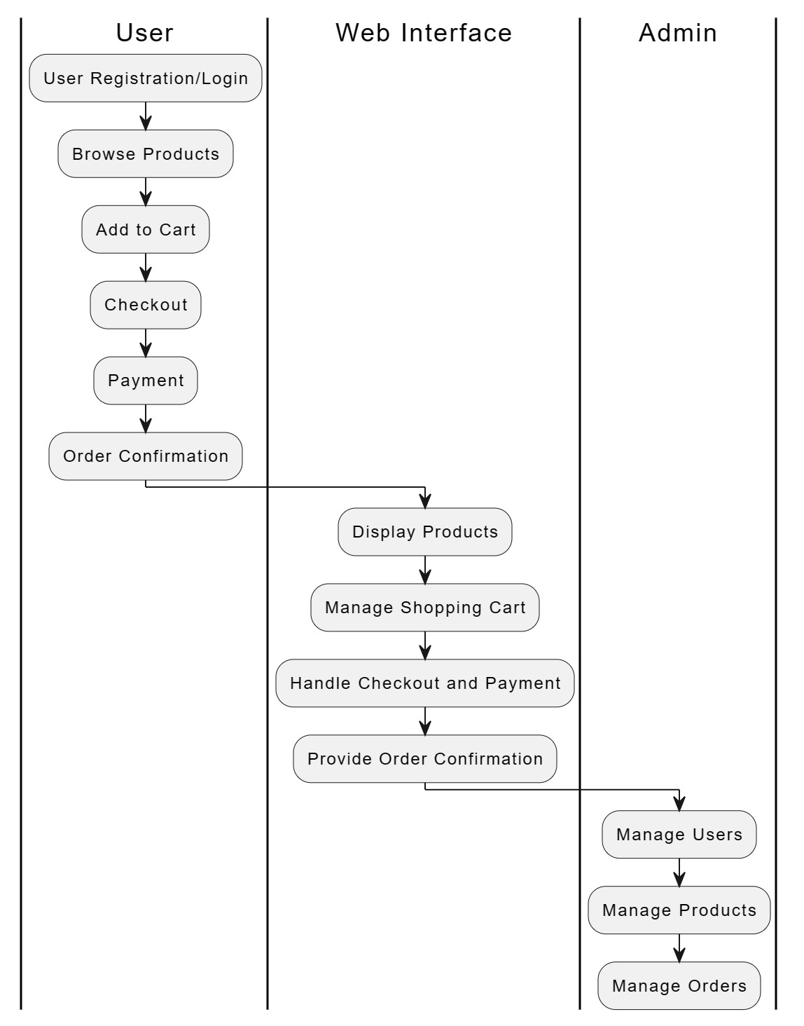
SYSTEM FLOW –
ACTIVITY DIAGRAM

Slide 19
KEY MODULES:
Add Products: This module allows the admin to add new products to the website, including details such as product name, description, price, and images.
Cart: The cart module enables users to add products they wish to purchase. It dynamically updates as users add or remove products.
Login/Register: These modules handle user authentication. Users can register a new account or log in to an existing one.
Send Mail: This module sends automated emails to users for various triggers such as registration confirmation, password reset, and order confirmation.
Order Table/Order Success: These modules manage the user’s orders. The Order Table keeps track of all orders placed by a user, while the Order Success module confirms successful transactions.
Product Details: This module displays detailed information about a product when a user selects it, including price, description, and reviews.
Profile: The profile module allows users to manage their personal information, view order history, and update shipping details.
Razorpay Demo: This module integrates the Razorpay payment gateway for secure online transactions.
Shipping: The shipping module manages the delivery process. It includes features like tracking delivery and updating shipping addresses.

Slide 20
ADVANTAGES AND LIMITATIONS
Advantages:
User-Friendly: The website is designed to be intuitive and easy to navigate, enhancing the user experience.
Secure: With secure user authentication and payment gateway integration, the website ensures the security of user data and transactions.
Efficient: The efficient design of the database and order management system ensures smooth operation of the website.
Scalable: Built with Django, the website can easily be scaled to accommodate growth in user traffic and product catalog size.
Limitations:
Dependency on Django: As the website is built using Django, any limitations or issues inherent to Django could affect the website.
Maintenance: Regular updates and maintenance are required to keep the website secure and efficient.
Learning Curve: For new developers, there might be a learning curve to understand and work with Django and the project’s codebase.
Internet Dependency: As an online platform, the website requires a stable internet connection for access and operation.

Slide 21
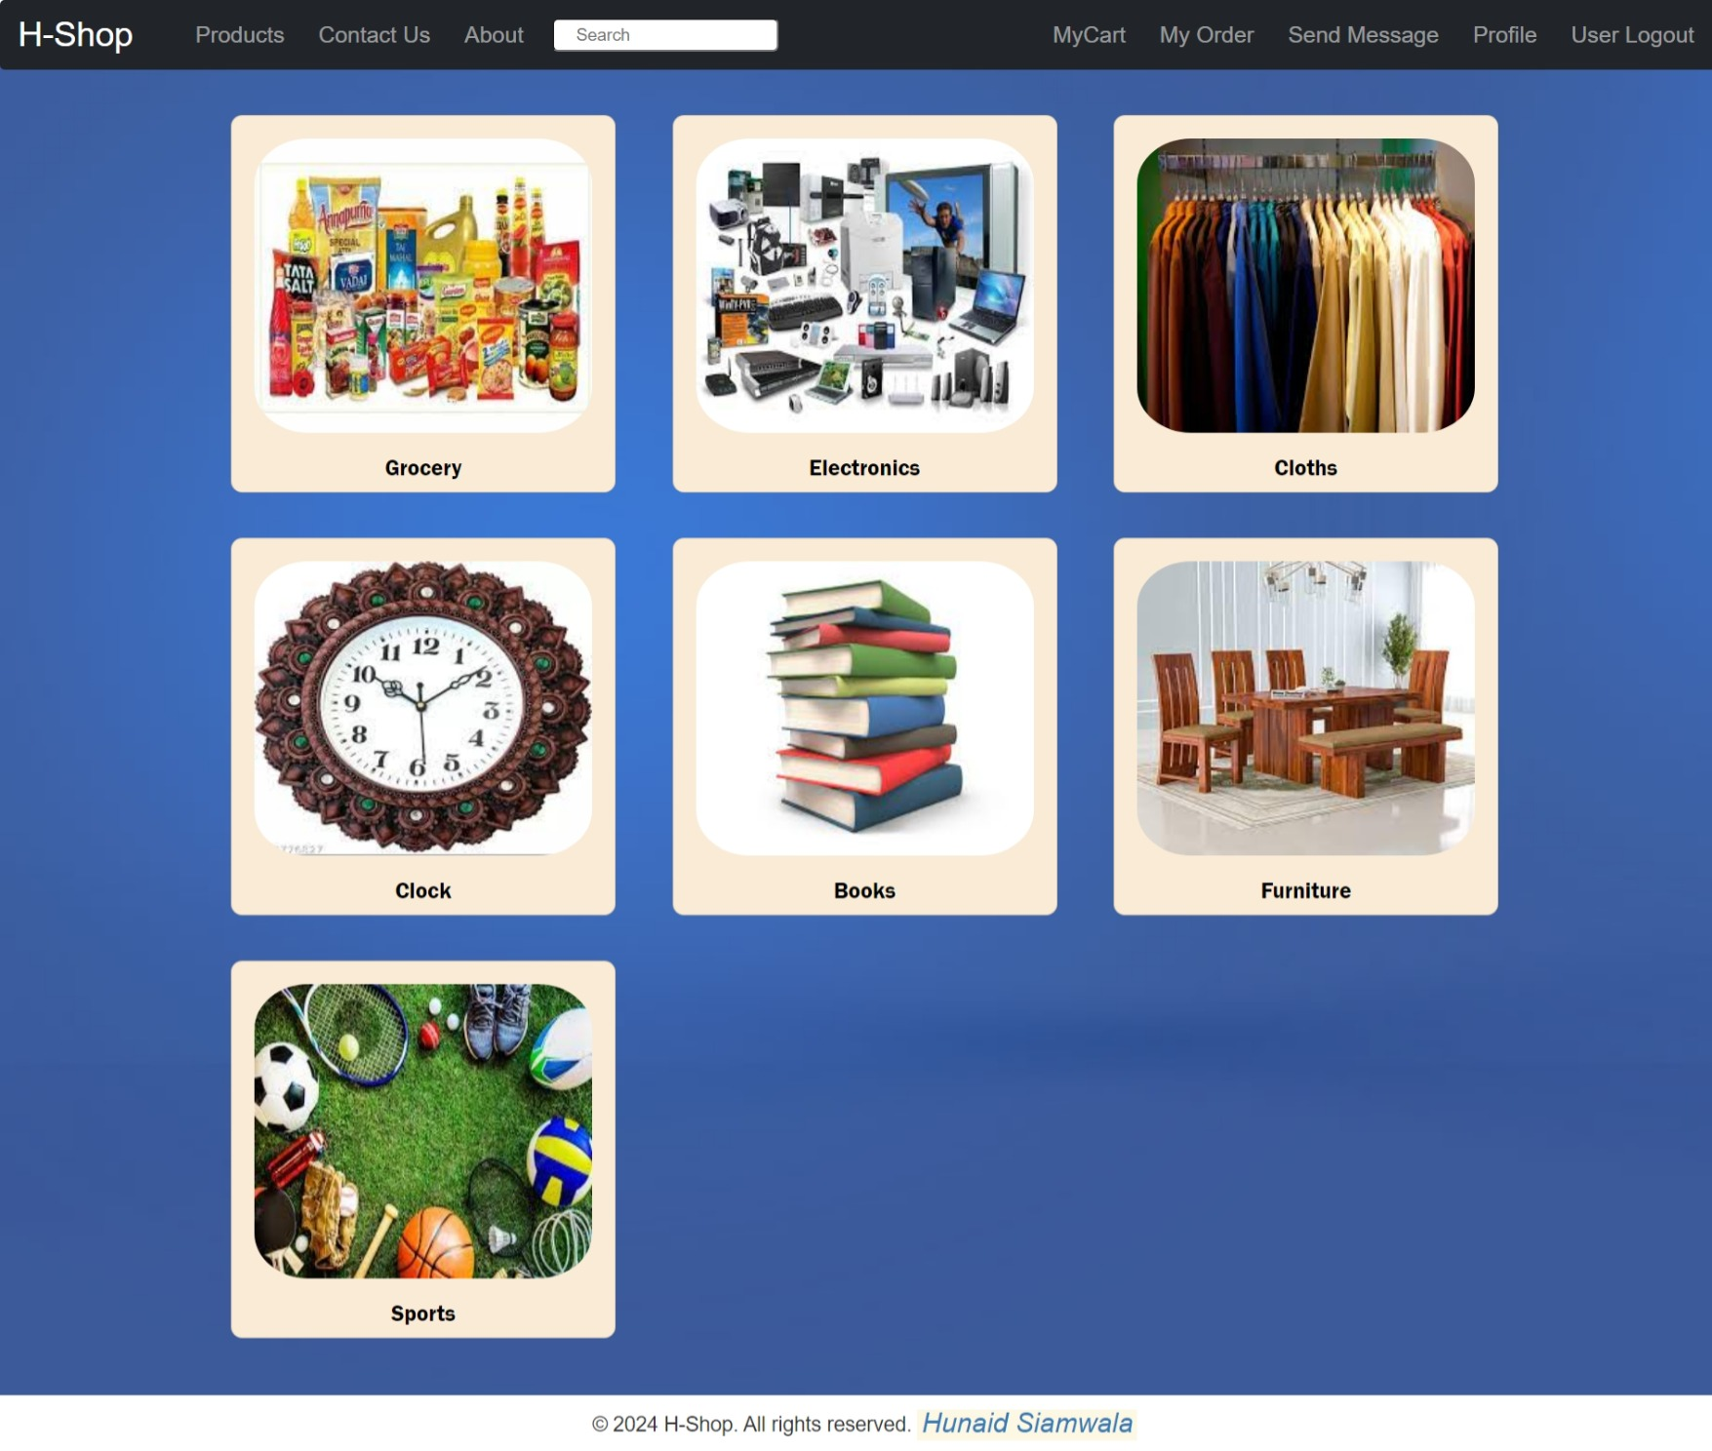
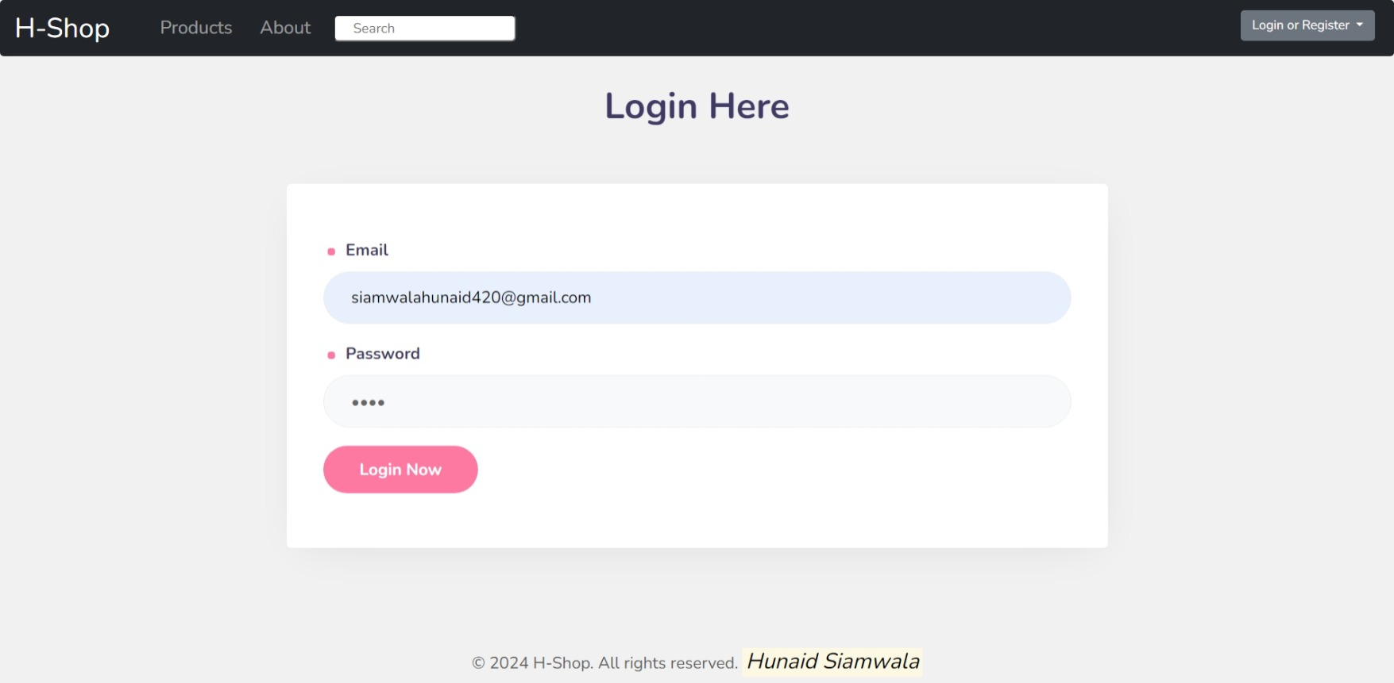
IMPLEMENTATION

Slide 22
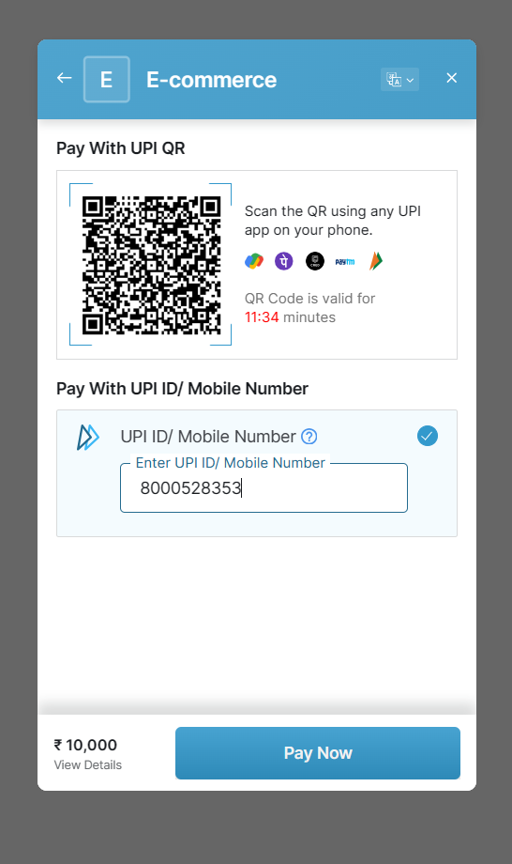
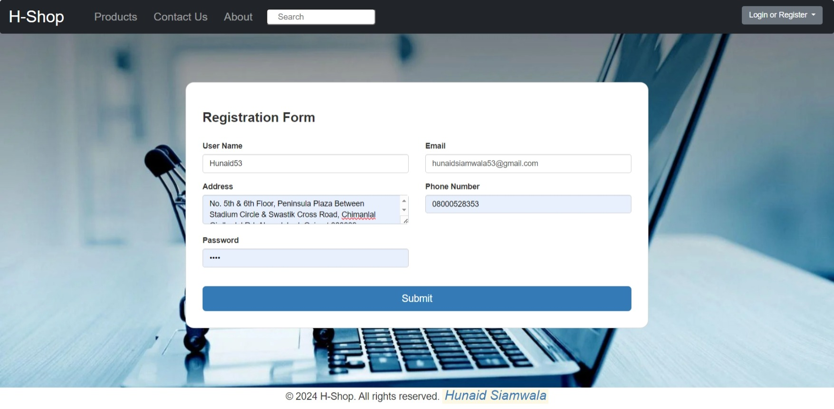
IMPLEMENTATION

Slide 23
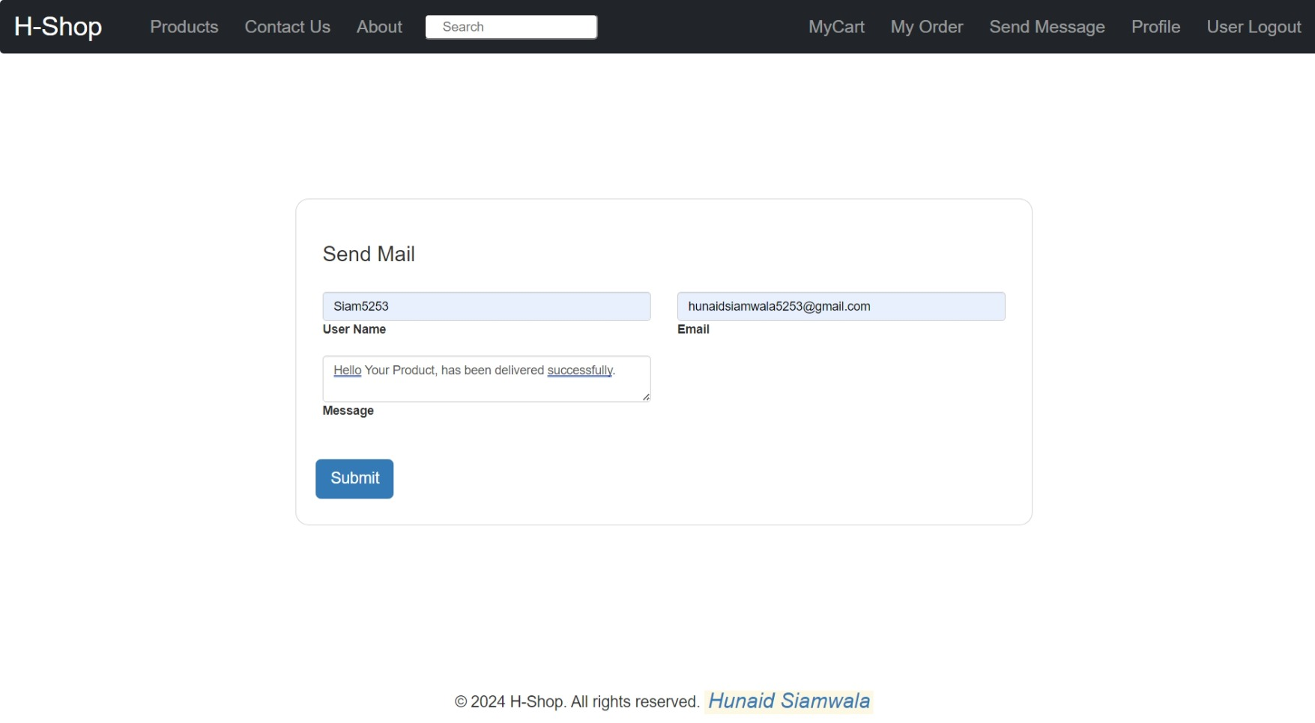
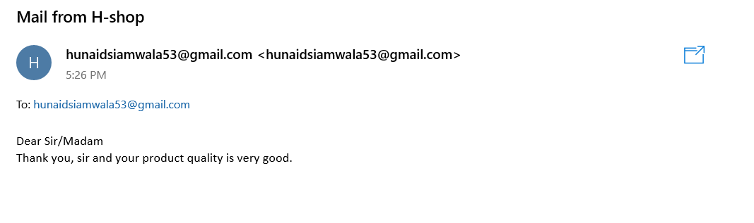
IMPLEMENTATION

Slide 24
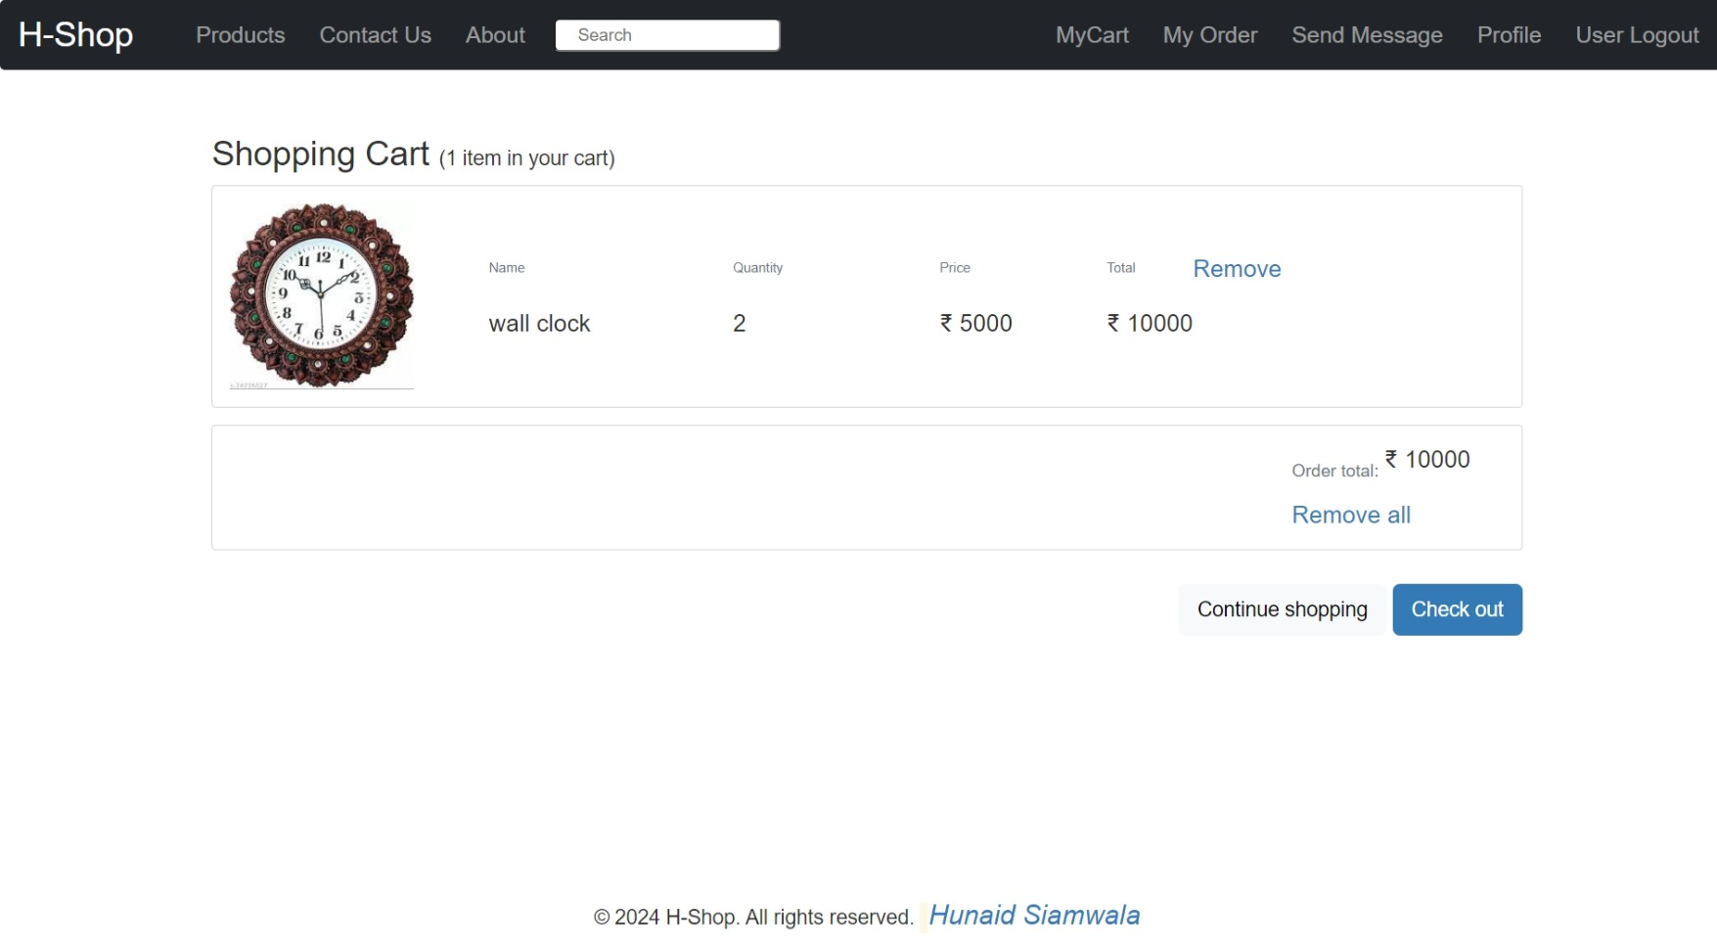
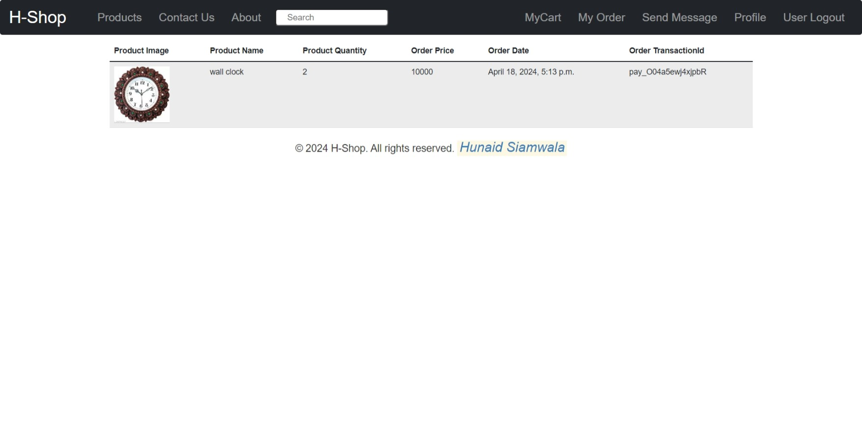
IMPLEMENTATION

Slide 25
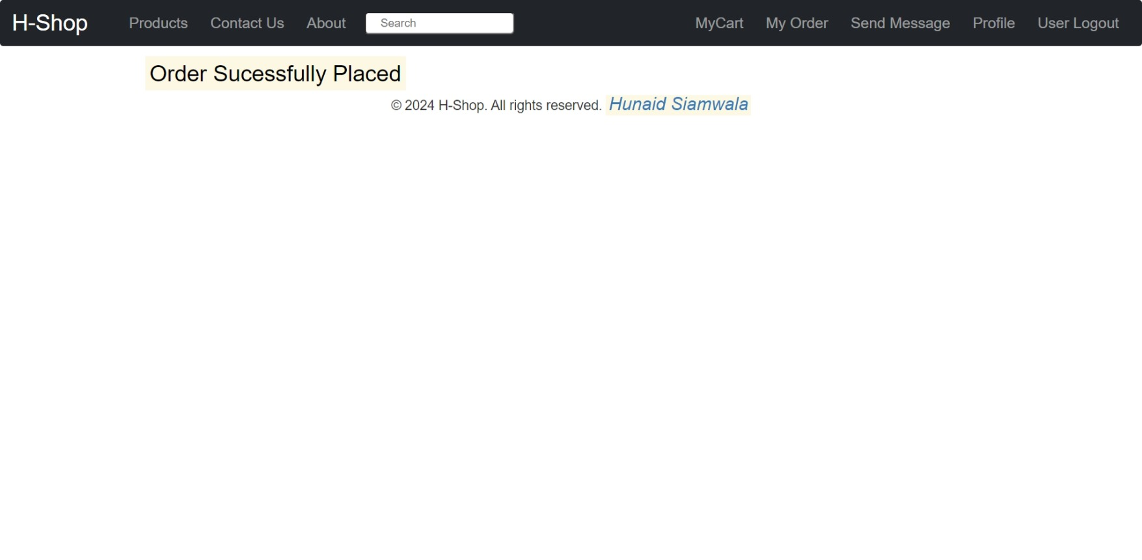
IMPLEMENTATION

Slide 26
FUTURE SCOPE
The future scope of this e-commerce website project is vast and promising. Here are a few possibilities:
Expansion of Product Catalog: The product catalog can be expanded to include a wider variety of items, catering to a broader audience.
Advanced Search and Recommendation Systems: Implementing machine learning algorithms for advanced search and personalized product recommendations can significantly enhance the user experience.
Mobile Application: A mobile application version of the website can be developed to provide users with more accessibility and convenience.
International Shipping: The shipping module can be expanded to support international shipping, opening up the platform to a global customer base.
Integration with Social Media: The website can be integrated with social media platforms for marketing purposes and to provide a more connected user experience.
Augmented Reality (AR) Shopping Experience: AR technology can be incorporated to provide a virtual “try before you buy” experience to users.

Slide 27
INTERNSHIP TIMELINE CHART
From 28th December
Learning to SDLC, SQL and Python and Introduction to Web Technology
February
Basics of HTML and CSS with all the properties and introduction to JavaScript. Python Programming with real world scenario and SQL completion of all the Statements
Advance JS and Python Programming having OOPS Concept
April
March
Django Framework and Project Work

Slide 28
CONCLUSION
My tenure as a Python Full Stack Developer intern at QSpiders has been a rewarding journey. The comprehensive training in SQL, Python, SDLC, Django and Web Technologies has strengthened my abilities, establishing a robust base for Full Stack Development. The path from gaining proficiency in SQL’s database management to exploring the complexities of Python programming and structured software development has been both demanding and fulfilling. My familiarity with Web Technologies, particularly HTML5 and CSS3, has broadened my potential for creating dynamic and responsive web applications.
I express my sincere thanks to the committed team at QSpiders for their guidance and assistance throughout this educational journey. This internship has equipped me with the understanding and self-assurance to set forth a prosperous career in Full Stack Development. I am eager to utilize these learned skills in practical projects and contribute significantly to the domain.

